Slide 1

AASD 4016
Full Stack Data Science Systems
Applied AI Solutions Developer Program

Slide 2
Module 2
Flask
Vejey Gandyer

Slide 3
Agenda
Flask
Requests
Response
Routes
Examples

Slide 4
Flask
Python Web Framework

Slide 5
Flask
Installing Flask
pip install Flask
Hello Flask Application (hello.py)
from flask import Flask
app = Flask(__name__)
@app.route("/")
def hello_world():
return "<p>Hello, World!</p>"

Slide 6
Flask
Running a Flask Application
export FLASK_APP=hello
flask run
Set Flask Environment
export FLASK_ENV=development

Slide 7
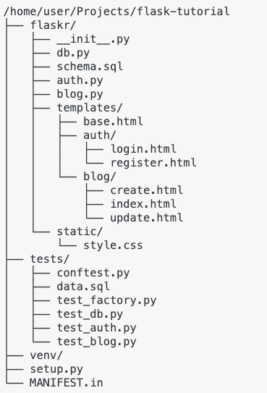
Project Structure

Slide 8
Flask project structure
Project Structure
app.py
helper(s).py [Optional]

Slide 9
Iris Classifier
Notebook to Script
Script to Flask
Load model and keep it up for inference
Infer from the model

Slide 10
HTTP Request Methods
GET
POST
PUT
HEAD
DELETE

Slide 11
GET
GET is used to request data from a resource
Query String is sent in the URL of a GET request
Developer Tools
/test_endpoint?name=subash&age=41

Slide 12
POST
POST is used to send data to a server to create / update a resource
Data sent to the server is stored in the request body of the HTTP request
Developer Tools
POST /test_endpoint HTTP/1.1 Host: iamsubash.com name=subash&age=41

Slide 13
PUT
PUT is used to send data to a server to create / update a resource
Calling PUT request multiple times produce the same result
Calling POST request multiple times produce multiple resources

Slide 14
HEAD
HEAD is identical to GET, but without the response body
HEAD requests are useful for checking what a GET request will return before actually making an actual GET request
Before downloading a very large file

Slide 15
DELETE
DELETE deletes the specified resource

Slide 16
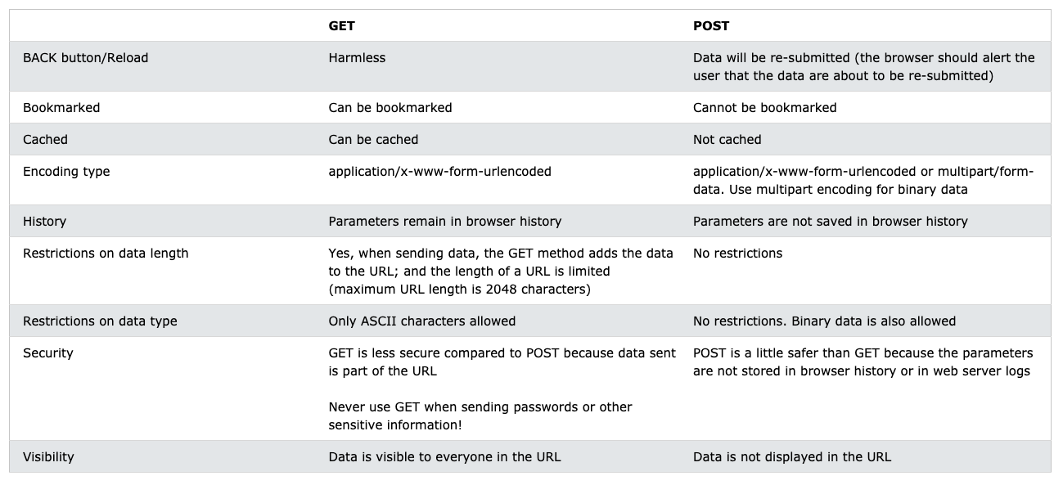
GET vs POST

Slide 17
Flask HTTP Methods
HTTP Methods
from flask import request @app.route('/login', methods=['GET', 'POST']) def login(): if request.method == 'POST': return do_the_login() else: return show_the_login_form()

Slide 18
Rendering Templates
from flask import render_template @app.route('/hello/') @app.route('/hello/<name>') def hello(name=None): return render_template('hello.html', name=name)

Slide 19
File uploads
from flask import request @app.route('/upload', methods=['GET', 'POST']) def upload_file(): if request.method == 'POST': f = request.files['the_file'] f.save('/var/www/uploads/uploaded_file.txt') ...

Slide 20
Secure File uploads
from werkzeug.utils import secure_filename @app.route('/upload', methods=['GET', 'POST']) def upload_file(): if request.method == 'POST': f = request.files['the_file'] f.save(f'/var/www/uploads/{secure_filename(f.filename)}') ...

Slide 21
Further Reading
Flask Tutorial
https://flask.palletsprojects.com/en/2.0.x/tutorial/

